Slide 1
Design Thinking: Simplified
An online, design thinking handbook for any UX student made by a UX student
THE MVP
Janelle chandass

Slide 2
PROBLEM
People with little or no UX design experience:
Find aspects of the design thinking process ambiguous. There is not always clear understanding of what comes next, which tools or techniques and when
Struggle with the development of some graphics like user flows
Think the process is time consuming, they often need to do a lot of research to find information on best practice or how to create a type of graphic
Have problems coming up with ideas
Other tutorials have large volumes of material, come with considerable time or monetary investment, sign-up

Slide 3
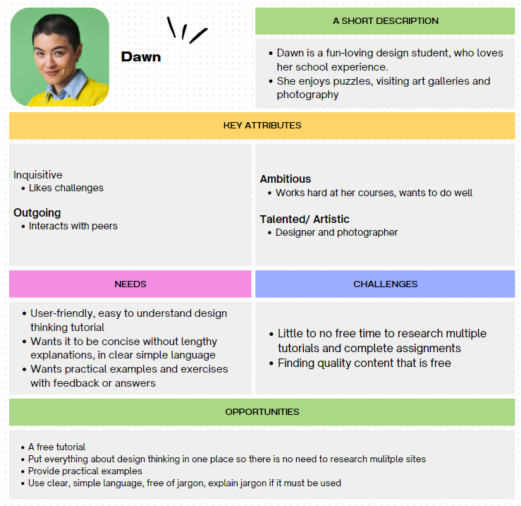
THE USER

Slide 4
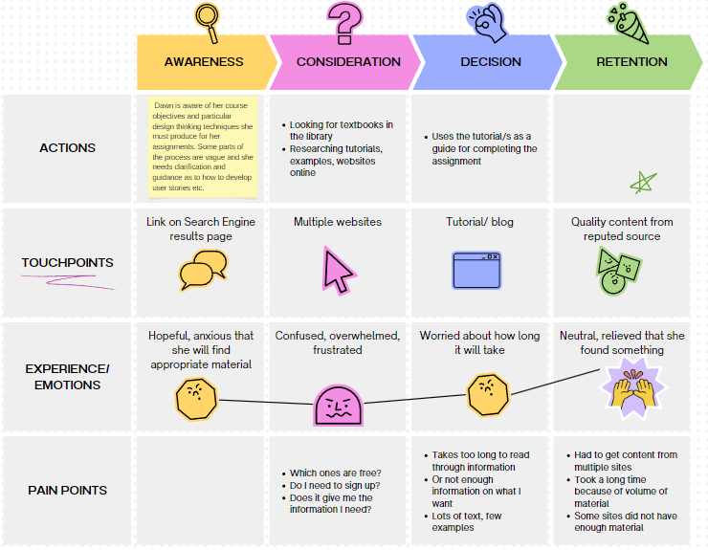
CURRENT JOURNEY MAP

Slide 5
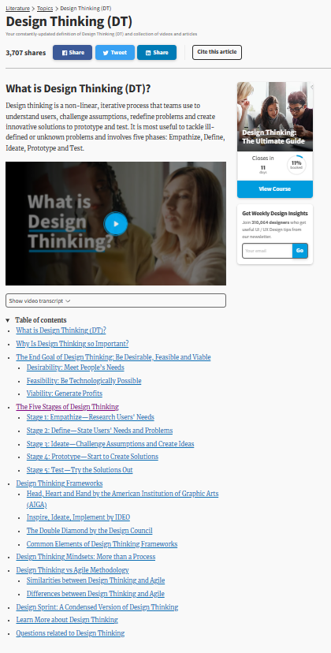

Slide 6
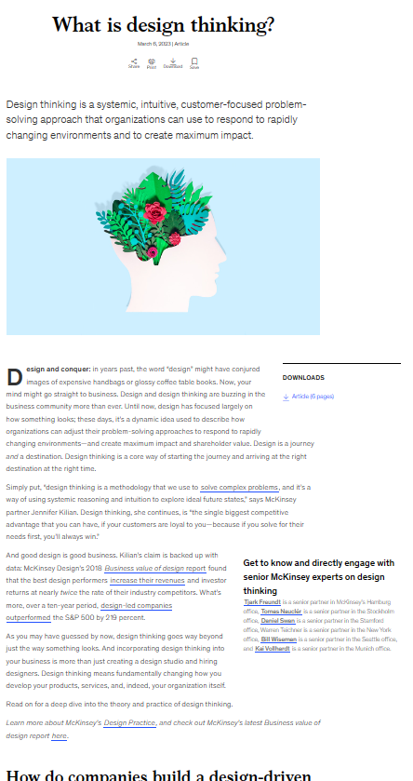

Slide 7
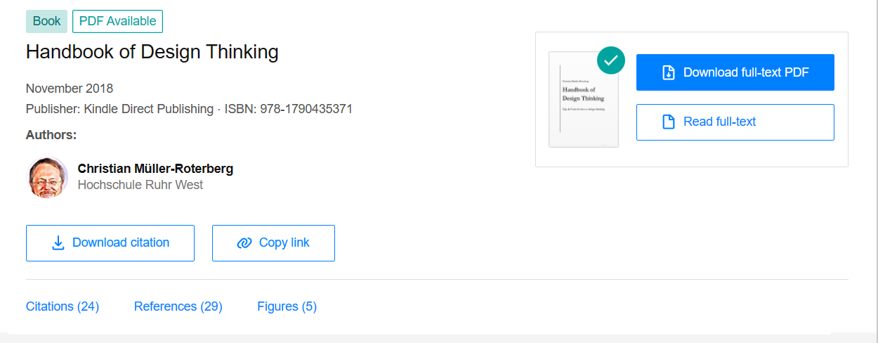

Slide 8
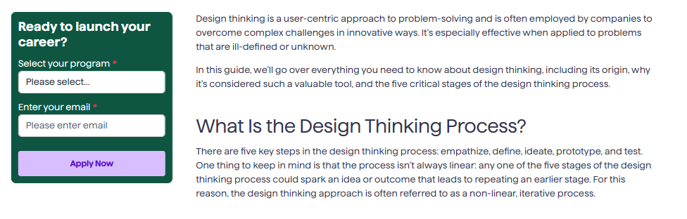


Slide 9
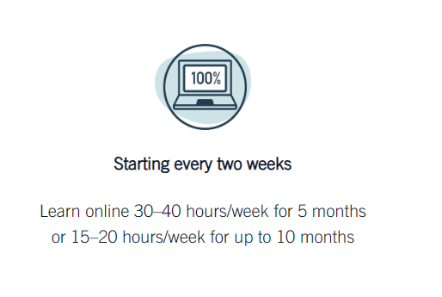

Slide 10
SOLUTION
Develop an easy-to-use online handbook with the following features
Clear and simple language
Clean and minimalist design since there will be diagrams etc
Responsiveness and accessibility

Slide 11
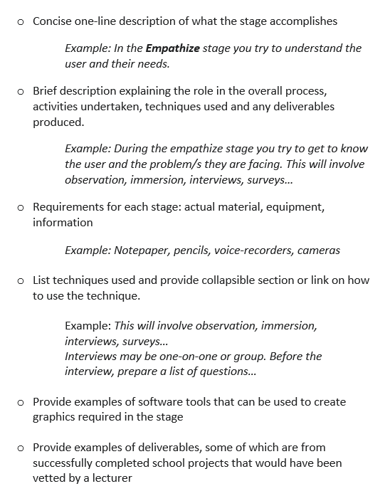
SOLUTION
For each of the five (5) design thinking stages provide

Slide 12
SOLUTION
For each of the five (5) design thinking stages provide

Slide 13
SOLUTION
Explain step-by-step, how graphics and other deliverables of the design thinking process (affinity diagrams, user stories, POV (point of view statement), low-fidelity wireframe, high-fidelity wireframe, test plan and tests) should be developed
Provide simple navigation to the five (5) design thinking stages as well as side panel navigation directly to techniques and tools
Provide a form for users who wish to contribute, request information on a particular topic or provide general feedback

Slide 14
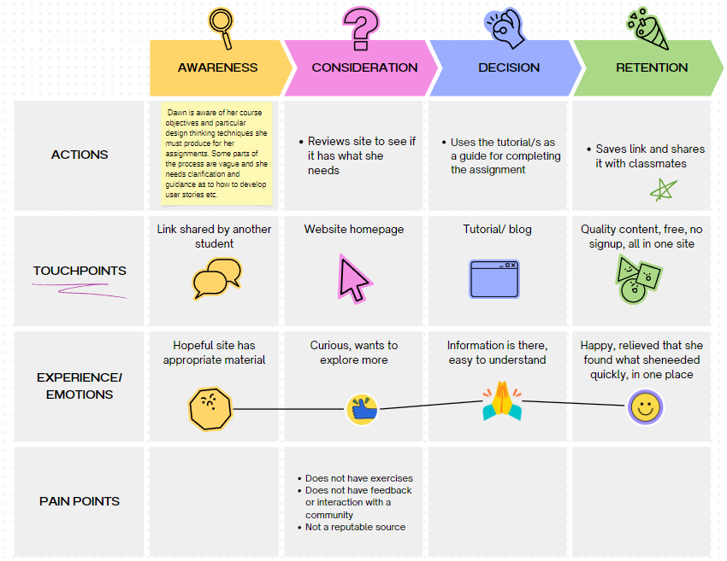
JOURNEY MAP WITH MVP

Slide 15
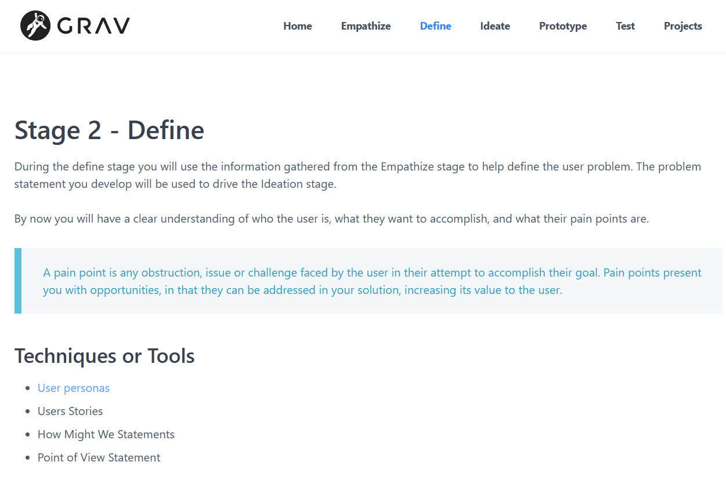
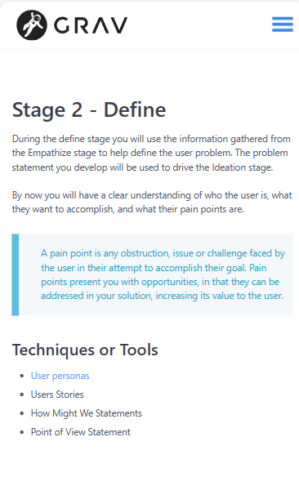

Slide 16
MVP
The MVP was built using Grav, a flat-file CMS which allows for the rapid development of a responsive website. Features that demonstrate idea
Clear and simple language
Clean and minimalist design since there will be diagrams etc
Responsiveness
List/ show the five (5) stages of the design thinking process: Empathize, Define, Ideate, Prototype, Test

Slide 17
MVP
For one of the five (5) design thinking stages provide
Concise one-line description of what the stage accomplishes
Example: In the Empathize stage you try to understand the user and their needs.
Brief description explaining the role in the overall process, activities undertaken, techniques used and any deliverables produced.
Example: During the empathize stage you try to get to know the user and the problem/s they are facing. This will involve observation, immersion, interviews, surveys…
List techniques used
Provide an example of a technique/ stage deliverable from successfully completed school project.

Slide 18
GRAV?
Pros | Cons
Simple installation No database and issues that arise with managing one Fast and lightweight Simple updates through files, clients can easily modify | Limited customization, especially in free version Since there is no database cannot handle advanced search options Utilizes Markdown, some users may have challenges with this

Slide 19
Alternative Solutions
YouTube Videos – narrated video split into chapters for each design thinking stage or a series of videos, each of which covers a different stage. The video will walk the user through the stage, the techniques used and how to develop the associated graphics and tools.
Pros | Cons
Engaging format Ease of distribution | Does not appeal to all learning styles Must be skilfully made to ensure user can navigate to relevant parts

Slide 20
Alternative Solutions
Interactive PDF – Similar to the online handbook, it will outline each stage at a higher level and provide links to more detailed descriptions, lists of techniques which also link to more detailed guides on how to apply the techniques.
Pros | Cons
Relatively small file that can be downloaded User can have access off-line | Generally requires special software to create Updates would not be reflected in downloaded document

Slide 21
Alternative Solutions
E-book, published via Kindle – Can be created like a regular book that provides information on each stage in separate chapters
Pros | Cons
Possibility to monetize for developer’s benefit and product improvement | User would require signup

Slide 22
Requires no account setup like a kindle e-book would. Displays content as text and images, can be used anywhere unlike YouTube video which has audio and may not play well in some areas due to network security restrictions or bandwidth Allows user to quickly jump to relevant parts
Why is this the best solution

Slide 23
BUILDING ON THE MVP
Review wireframes
Improve site accessibility
Improve SEO

Slide 24
BUILDING ON THE MVP
Add depth to content, that is build out each stage further
Explain step-by-step, how graphics and other deliverables should be developed
Provide examples of deliverables
Provide a form for users who wish to contribute, request information on a particular topic or provide general feedback
For each graphic/ stage deliverable list resources required to develop: actual material, equipment, information
Complete other design thinking stages

Slide 25
FEEDBACK ☺?
Are there any features or topics that can be added to the handbook?
Do you find the guidelines clear, easy to understand and concise?
Is this something a UX design student would use?

Slide 26
THANK YOU
Janelle Chandass
jchandass@northislandcollege.ca

